Slide 1
Digitalization of Peristaltic Pump
Presentation on 8th Semester Project ,under the guidance of
Dr. N M Renukappa
Presentation by,
Name | USN
Anirudh G | 4JC12EC018
Darshan A | 4JC12EC037
Mrithyunjaya | 4JC12EC064
M N Sunaada Hebbar | 4JC12EC058

Slide 2
To design and implement programmable peristaltic pump and enhance user interface for versatile applications
Development of software in embedded C programming language in order to facilitate different modes of operation such as calibration, volume based, time based, repetitive dispensing, discrete dispensing and serial communication modes using Arduino IDE software tool. The developed software will be running on Arduino MEGA microcontroller. In addition the software also provides user interface through GLCD display and Keypad.
Design and development of Micro-step Driver circuit to drive the stepper motor and provide smoother rotation and precise control. In addition to that interface between Arduino MEGA microcontroller and input/output devices like Graphic LCD and Keypad is designed. Further, RS485 serial communication port is designed to support interface between the system and external control devices.
Objective

Slide 3
Advantages of Peristaltic pump
Seal-less design
Peristaltic pumps have no seals avoiding issues such as leaks of corrosive chemicals and ongoing maintenance
Low maintenance costs
The only replacement part is the hose or tube a relatively low cost item that can be easily changed in a short time.
Reversible
Peristaltic pumps are reversible with just change in direction of rotation of motor
Accurate dosing
The pumps are accurate in dosing; they have a repeatability of ±1%
Dry running and self-priming
Peristaltic pumps do not require pumped fluid to be continually present pumps can run dry, without costly downtime or repairs.

Slide 4
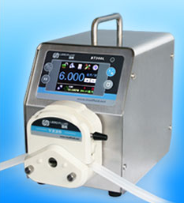
Applications
Medicine
Medical infusion pumps.
Dialysis machines.
Chemical handling
Pharmaceutical production.
Dosing systems for dishwasher and laundry chemicals.
Chemical treatment in water purification plant.
Testing and research
Auto Analyzer.
Analytical chemistry experiments.
BT100L Peristaltic Pump

Slide 5
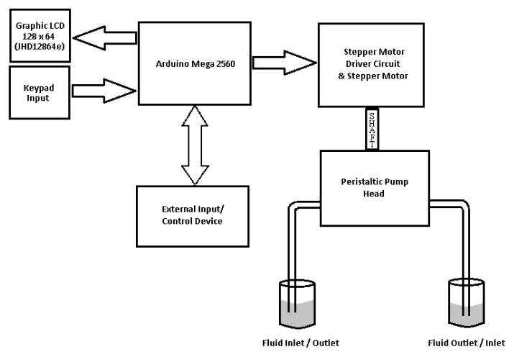
Block Diagram of Peristaltic Pump

Slide 6
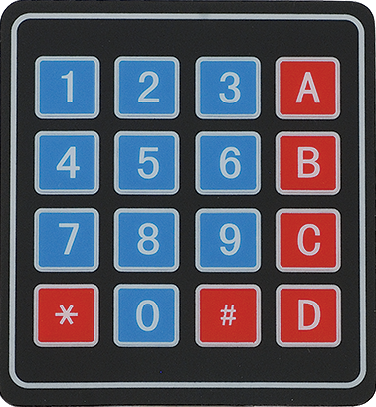
Input : 4X4 Numeric Keypad
Numeric keypad has 16 keys arranged in the form of a 4X4 matrix.
The A, B, C, D, * and # keys can be used as navigation keys or special function keys.
It has 8 pins which are connected to Arduino MEGA Digital I/O Pins.

Slide 7
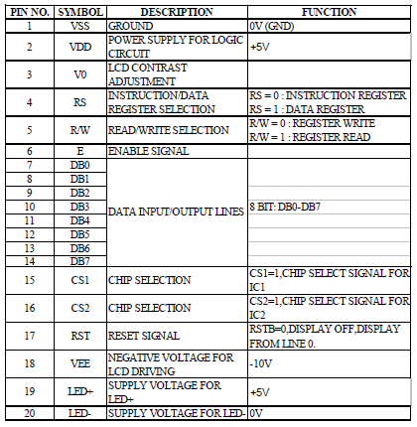
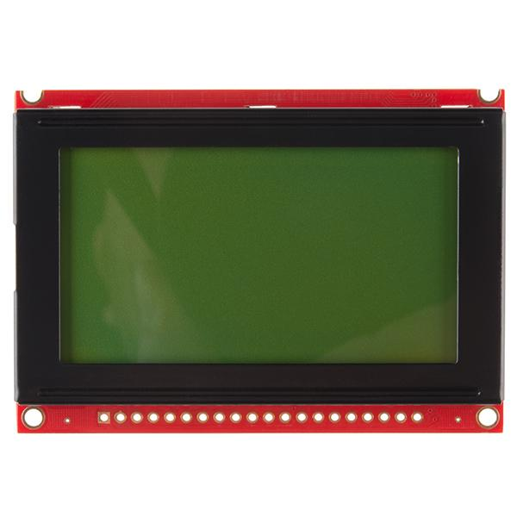
Output : Graphical LCD Display
JHD12864E GLCD
128X64 pixel JHD12864E Graphic LCD is used
Pin description
The LCD module has 20 pins and it is used in 8 bit parallel mode for interfacing it with Arduino MEGA
LCD features Intensity control of Backlight and contrast control

Slide 8
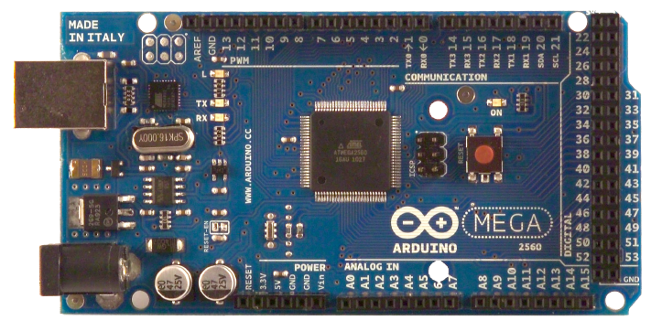
Microcontroller Board : Arduino Mega
It has 54 digital input/output pins (of which 14 can be used as PWM outputs), 16 analog inputs, 4 UARTs (hardware serial ports), a 16 MHz crystal oscillator, a USB connection, a power jack, an ICSP header, and a reset button.
4X4 Keypad and 128 X 64 Graphical LCD Display (JHD12864E) is interfaced with Arduino MEGA
The Microcontroller controls the rpm of the stepper motor which in turn controls the rate of dispensing the fluid.
Arduino MEGA 2560
The motor driver circuit amplifies the signals from controller to provide the required drive current to the stepper motor.
The Microcontroller generates appropriate signals to control the motor and also provides interface for RS485 communication port which enables connection of other devices to the microcontroller.

Slide 9
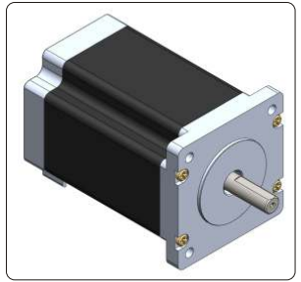
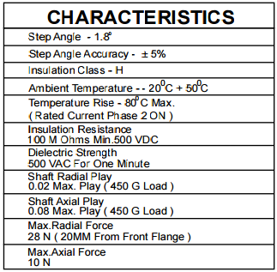
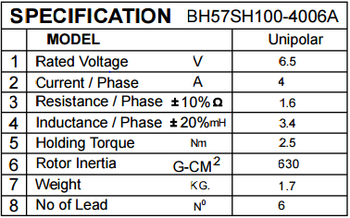
Stepper Motor
BH57SH100 – 4006A manufactured by
Bholanath Engineering Industries is used.
BH57SH100 – 4006A

Slide 10
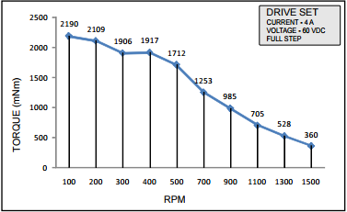
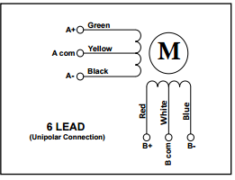
Torque Vs RPM Graph of Motor
Wiring Diagram of BH57SH100 – 4006A

Slide 11
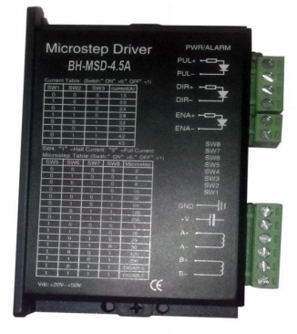
Stepper Motor Driver
BH-MSD-4.5A Micro stepping Driver is used.
Micro stepping driver is particularly suitable
for the applications desired with extremely
low noise and low temperature rise .
Microstepping: 1/2, 1/4, 1/8, 1/16, 1/32,
1/64, 1/128, 1/256
Electrical specification:
Parameter | Minimum | Maximum | Unit
Input voltage(DC) | 20 | 50 | V
Output current | 1.5 | 4.5 | A

Slide 12
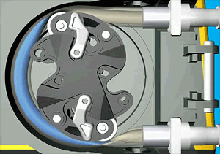
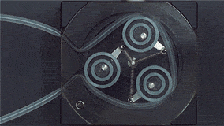
Peristaltic Pump Head
Works based on the principle of alternating compression and relaxation of the tube drawing the fluid contents from one container and dispensing it to the other.
A rotating roller passes along the length of the tube totally compressing it and creating a seal between suction & discharge side of the pump
Support different sized fluid tubes
Many versions of YZ and DG series compatible with BT100L available with
2, 4, 6 and 10 rollers
3 Roller Pump Head
2 Roller Pump Head

Slide 13
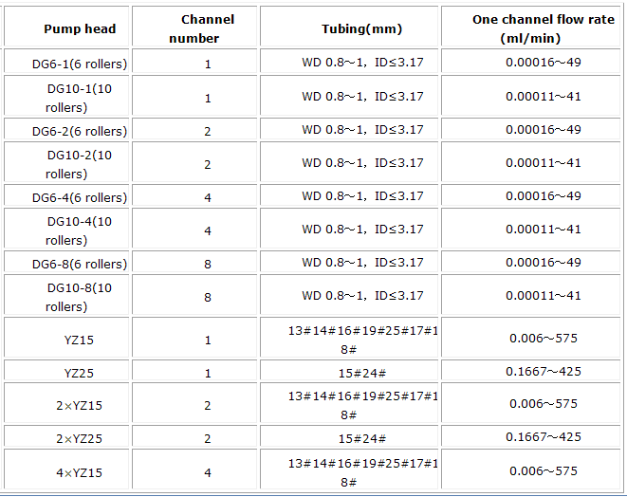
Pump Head and Tube Specification
* WD = Tube Wall Diameter, ID = Tube Inner Diameter

Slide 14
Features
1) Programmable Configuration
Selection of Pump Head
Selection of Tube Size
2) Bidirectional Operation
Switch to select direction of operation – Forward/Reverse
3) Calibration
The user can select calibrate option to manually calibrate the flow rate for the selected pump head and tube size
The calibration algorithm is as shown in the Flow chart in the next slide
The user is prompted to calibrate after using the tube many times in order to compensate for the change in flow rate due to expansion of tube.

Slide 15
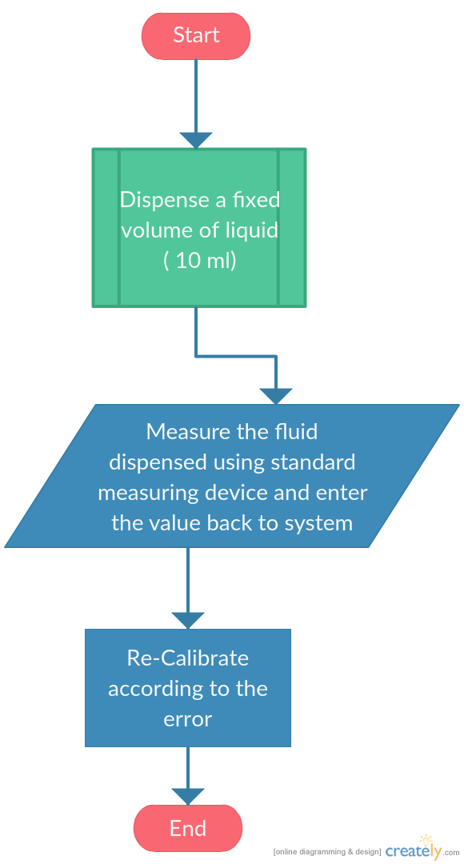
* Make sure that the tube is completely filled with fluid before initiating calibration process

Slide 16
4)Volume based mode:
I/p: Volume to be dispensed
O/p: Dispensing the required volume of liquid
Configurable Options:
Different flow rate dispensing mode – The fluid can be dispensed at Min/Average/Max flow rates (with default average flow rate)
Start foot switch
5) Time based Mode:
I/p: Volume of Liquid in ml, Time in min.
O/p: Dispensing the required volume of liquid in specified time
6) Repetitive Dispensing Mode:
I/p: Process Duration in hours , Duration Between Samples in min , Volume of Liquid to be Dispensed for each Sample in ml
O/p: The specified Volume of Liquid is Dispensed between samples at a Default Flow Rate (50% of maximum)

Slide 17
7) Discrete Dispensing Mode:
I/p: Process Duration in hours, Duration Between samples in min, Volume of Liquid to be Dispensed for each sample in ml, Flow rate in ml/min
O/p: The specified Volume of Liquid is Dispensed between samples at the specified Flow Rate
8) Serial Communication Mode:
I/p: Weight of the Liquid to be Dispensed in grams
A weight balance weighs the liquid dispensed and the reading is sampled by the microcontroller through RS485 Serial Communication Port
O/p: Once the Specified weight of the Liquid is Dispensed the microcontroller stops the liquid flow
9) Dosing Profile Saving:
It allows the user to save the dozing parameters
The user can use these profiles for faster acess

